Slide 1
Regression Analysis
Multiple Linear Regression
Nicoleta Serban, Ph.D.
Professor
School of Industrial and Systems Engineering
Predicting Demand for Rental Bikes: P-values and Large Sample Size

Slide 2

About This Lesson

Slide 3
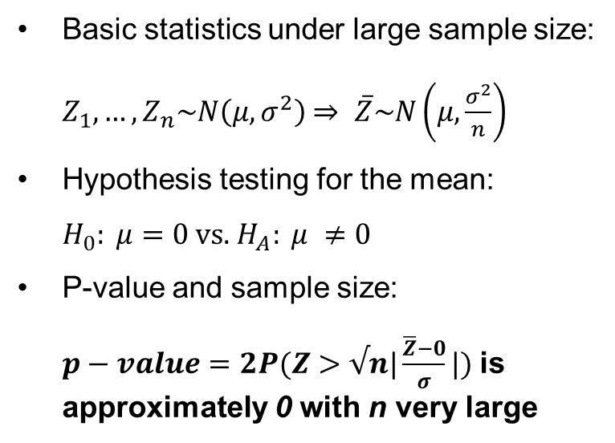
The P-value Problem: Basis Statistics
Basic statistics under large sample size:
$Z_{1},…, Z_{n}\sim N\left(μ,σ^{2}\right)$ $⇒ \overline{Z}\sim N\left(μ,\frac{σ^{2}}{n}\right)$
Hypothesis testing for the mean:
$H_{0}: μ=0$ vs. $H_{A}: μ ≠0$
P-value and sample size:
$p−value=2P(Z>√n|\frac{\overline{Z}−0}{σ}|)$ is approximately 0 with n very large
“Inflated” Significance: Conclusions based on small-sample statistical inferences using large samples can be misleading.
Samples Can Make the Insignificant...Significant!

Slide 4
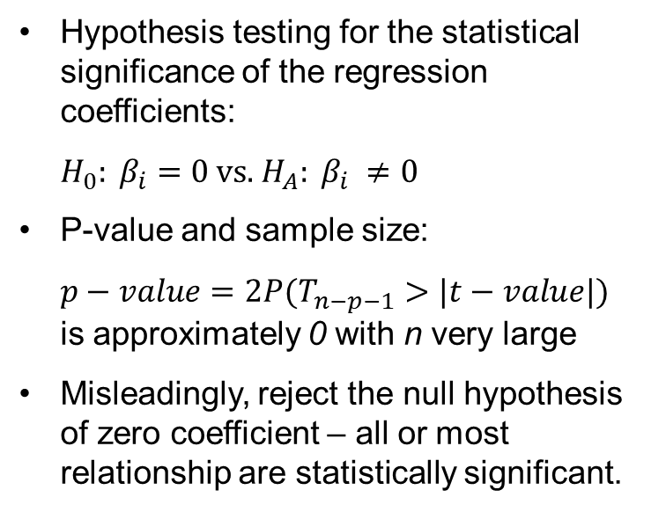
The P-value Problem: Regression Analysis
Hypothesis testing for the statistical significance of the regression coefficients:
$H_{0}: β_{i}=0$ vs. $H_{A}: β_{i} ≠0$
P-value and sample size:
$p−value=2P(T_{n−p−1}>|t−value|)$ is approximately 0 with n very large
Misleadingly, reject the null hypothesis of zero coefficient – all or most relationship are statistically significant.
“Inflated” Statistical Significance: Conclusions based on small-sample statistical inferences on the regression coefficients using large samples can be misleading.

Slide 5
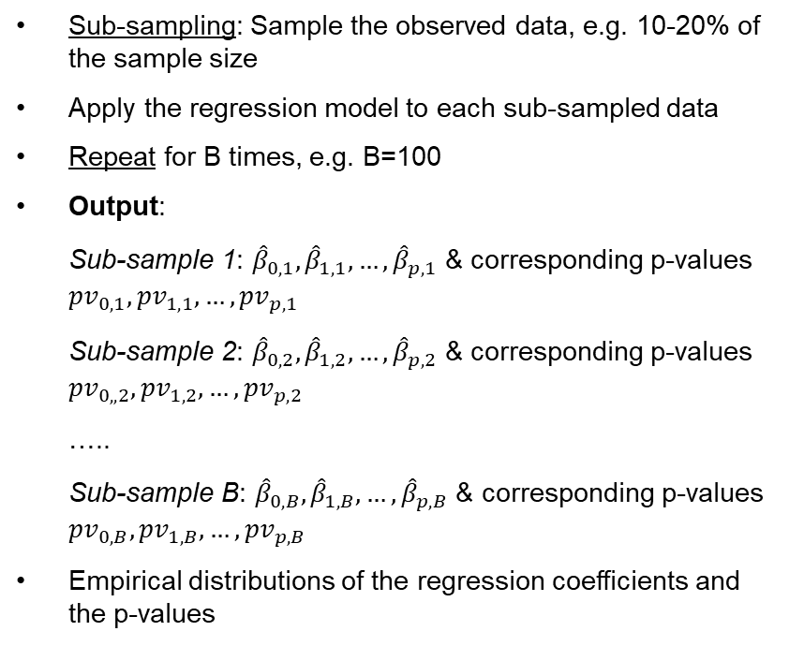
The P-value Problem: Approach
Sub-sampling: Sample the observed data, e.g. 10-20% of the sample size
Apply the regression model to each sub-sampled data
Repeat for B times, e.g. B=100
Output:
Sub-sample 1: ${\hat{β}}_{0,1}, {\hat{β}}_{1,1}, …,{\hat{β}}_{p,1}$ & corresponding p-values ${pv}_{0,1}, {pv}_{1,1}, …,{pv}_{p,1}$
Sub-sample 2: ${\hat{β}}_{0,2}, {\hat{β}}_{1,2}, …,{\hat{β}}_{p,2}$ & corresponding p-values ${pv}_{0,,2}, {pv}_{1,2}, …,{pv}_{p,2}$
…..
Sub-sample B: ${\hat{β}}_{0,B}, {\hat{β}}_{1,B}, …,{\hat{β}}_{p,B}$ & corresponding p-values ${pv}_{0,B}, {pv}_{1,B}, …,{pv}_{p,B}$
Empirical distributions of the regression coefficients and the p-values

Slide 6
The P-value Problem: Approach
Sub-sampling: Sample the observed data, e.g. 10-20% of the sample size
Apply the regression model to each sub-sampled data
Repeat for B times, e.g. B=100
Output:
Sub-sample 1: ${\hat{β}}_{0,1}, {\hat{β}}_{1,1}, …,{\hat{β}}_{p,1}$ & corresponding p-values ${pv}_{0,1}, {pv}_{1,1}, …,{pv}_{p,1}$
Sub-sample 2: ${\hat{β}}_{0,2}, {\hat{β}}_{1,2}, …,{\hat{β}}_{p,2}$ & corresponding p-values ${pv}_{0,,2}, {pv}_{1,2}, …,{pv}_{p,2}$
…..
Sub-sample B: ${\hat{β}}_{0,B}, {\hat{β}}_{1,B}, …,{\hat{β}}_{p,B}$ & corresponding p-values ${pv}_{0,B}, {pv}_{1,B}, …,{pv}_{p,B}$
Empirical distributions of the regression coefficients and the p-values
Theoretical Underpinning:
Statistical significance (or lack of it) can be identified based on the distribution of the p-values; specifically, if the empirical distribution is approximately uniform between 0 and 1, then we don’t have statistical significance.
Statistical significance (or lack of it) can be identified based on the confidence interval of the regression coefficient derived from the empirical distribution.

Slide 7
The P-value Problem: Approach (cont’d)
## Approach: Subsample 40% of the initial data sample & repeat 100 times
count = 1
n = nrow(train)
B = 100
ncoef = dim(summary(model1)$coeff)[1]
pv_matrix = matrix(0,nrow = ncoef,ncol = B)
while (count <= B) {
# 40% random sample of indices
subsample = sample(n, floor(n*0.4), replace=FALSE)
# Extract the random subsample data
subdata = train[subsample,]
# Fit the regression for each subsample
submod = lm(sqrt(cnt)~.,data=subdata)
# Save the p-values
pv_matrix[,count] = summary(submod)$coeff[,4]
# Increment to the next subsample
count = count + 1
}
# Count pvalues smaller than 0.01 across the 100 (sub)models
alpha = 0.01
pv_significant = rowSums(pv_matrix < alpha)

Slide 8
Statistical Significance
## Which regression coefficients are statistically significant?
idx_scoef = which(pv_significant>=95)
## Show the p-values of the significant coefficients in model2
cbind(summary(model2)$coeff[idx_scoef,c(1,4)],
Freq=pv_significant[idx_scoef])
## Plot the 100 p-values of the significant coefficients
matplot(pv_matrix[idx_scoef,],
xlab="Regression Coefficient Index",
ylab="P-values across 100 Samples",
type="p",
pch="o",
col=gtblue)
 | Estimate | Pr(>|t|) | Freq
(Intercept) | 1.670 | 0 | 100
season2 | 1.370 | 0 | 100
season3 | 1.380 | 0 | 100
season4 | 2.720 | 0 | 100
yr1 | 2.800 | 0 | 100
hr1 | -1.630 | 0 | 100
hr2 | -2.570 | 0 | 100
hr3 | -3.770 | 0 | 100
hr4 | -4.190 | 0 | 100
hr5 | -2.360 | 0 | 100
hr6 | 1.480 | 0 | 100
hr7 | 6.820 | 0 | 100
hr8 | 10.700 | 0 | 100
hr9 | 7.500 | 0 | 100
hr10 | 5.440 | 0 | 100
hr11 | 6.210 | 0 | 100
hr12 | 7.450 | 0 | 100
hr13 | 7.310 | 0 | 100
hr14 | 6.770 | 0 | 100
hr15 | 7.090 | 0 | 100
hr16 | 9.020 | 0 | 100
hr17 | 12.700 | 0 | 100
hr18 | 12.100 | 0 | 100
hr19 | 9.440 | 0 | 100
hr20 | 7.020 | 0 | 100
hr21 | 5.380 | 0 | 100
hr22 | 3.860 | 0 | 100
hr23 | 2.000 | 0 | 100
holiday1 | -0.986 | 0 | 98
weekday5 | 0.723 | 0 | 99
weathersit3 | -2.650 | 0 | 100
hum | -2.580 | 0 | 100

Slide 9
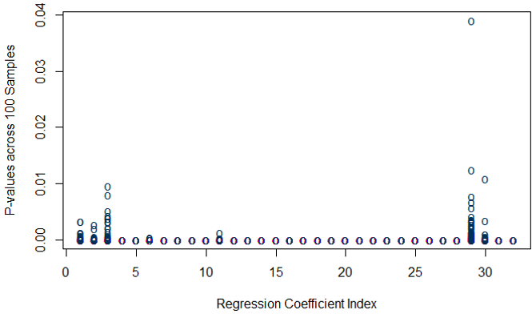
Statistical Significance (cont’d)
Statistical significance: Most P-values are small across all sub-samples

Slide 10
Lack Statistical Significance
# Which regression coefficients are not statistically significant?
idx_icoef = which(pv_significant<85)
# Show the p-values of the significant coefficients in model2
cbind(summary(model2)$coeff[idx_icoef,c(1,4)],
Freq=pv_significant[idx_icoef])
# Plot the 100 p-values of the significant coefficients
matplot(pv_matrix[idx_icoef,],
xlab="Regression Coefficient Index",
ylab="P-values across 100 Samples",
type="p",
pch="o",
col=gtblue)
 | Estimate | Pr(>|t|) | Freq
mnth2 | 0.379 | 0.005 | 12
mnth3 | 0.676 | 0.000 | 68
mnth4 | 0.516 | 0.021 | 11
mnth5 | 1.108 | 0.000 | 66
mnth6 | 0.499 | 0.043 | 7
mnth7 | -0.326 | 0.240 | 1
mnth8 | 0.300 | 0.267 | 2
mnth9 | 1.052 | 0.000 | 64
mnth10 | 0.516 | 0.020 | 7
mnth11 | -0.241 | 0.260 | 1
mnth12 | -0.038 | 0.826 | 0
weekday1 | 0.229 | 0.024 | 9
weekday2 | 0.174 | 0.080 | 4
weekday3 | 0.283 | 0.004 | 16
weekday4 | 0.344 | 0.001 | 35
weekday6 | 0.530 | 0.000 | 79
weathersit2 | -0.346 | 0.000 | 74
temp | 3.847 | 0.000 | 38
atemp | 4.879 | 0.000 | 84
windspeed | -1.101 | 0.000 | 59

Slide 11
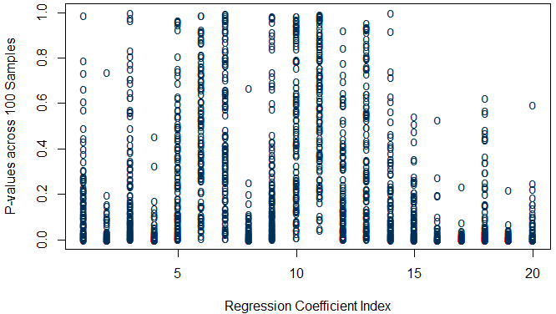
Lack Statistical Significance
Lack of statistical significance: Uniform Distribution of P-values

Slide 12
Statistical Significance Summary
Most regression coefficients remain statistically significant for 95% of the sub-samples, supporting statistical significance for these factors
Statistical significance is not supported for most of months and weekdays as well as for temperature and windspeed factors given that other relevant factors, such as season and weather situation are in the model.
While the 85% cutoff was used for the frequency of p-values being smaller than the significance level 0.01, other lower cut-offs, such as 50%, can be used.

Slide 13

Summary

